Slide 1
AI-Driven NPU-Enabled Battery Management for Electric Vehicles: Predictive Cell Voltage and Optimization Planning

Slide 2
Abstract
Electric vehicle battery packs consist of hundreds of lithium-ion cells that degrade at different rates during real-time driving. Conventional battery management systems rely on threshold-based monitoring and average measurements, which are unable to predict individual cell behavior accurately. This limitation often leads to sudden voltage drops, reduced driving range, and undetected cell imbalance that affects overall system performance.
This project presents an AI-driven, NPU-enabled Battery Management System for electric vehicles that performs real-time cell voltage modeling and optimization planning. A Gated Recurrent Unit (GRU) network is used to forecast future voltage trends of individual cells based on historical sensor data. K-Means clustering is then applied to categorize cells according to their operating condition, enabling the system to identify weak or unstable cells at an early stage. The entire inference pipeline is deployed on a Neural Processing Unit (NPU) to achieve high-speed computation with minimal power consumption.

Slide 3
The proposed system supports proactive balancing and intelligent control actions to maintain uniform voltage distribution across the battery pack. By enabling real-time prediction and optimization planning at the edge, this approach improves operational reliability, extends battery lifespan, and enhances overall electric vehicle performance without relying on cloud connectivity.

Slide 4
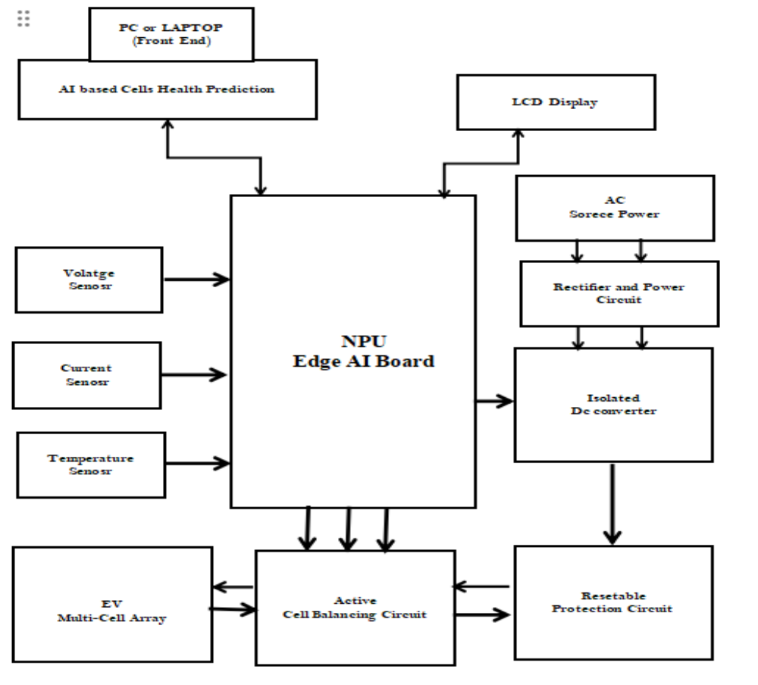
Block diagram

Slide 5
Existing system
1)Conventional battery management systems monitor average pack voltage and current.Alerts are generated only when predefined voltage or temperature limits are exceeded.
2)Individual cell behavior or early imbalance cannot be predicted.Weak or degrading cells are detected only after significant performance drop.
3)Only basic passive cell balancing is applied.No active optimization is performed to maintain uniform cell voltage.
4)Processing is slow and limited to simple threshold-based decisions.Real-time monitoring and analysis of all cells is not possible.
5)No AI or advanced computing is used for prediction.The system cannot forecast future cell behavior or prevent issues proactively.

Slide 6
Proposed syetem
1.The system uses an NPU-enabled processor for high-speed computation.GRU-based models predict individual cell voltages in real time.
2.K-Means clustering categorizes cells based on their operating condition.Weak or unstable cells are identified before they affect overall performance.
3.Active cell balancing is applied based on prediction and optimization.Voltage is maintained uniformly across the battery pack during operation.
4.Real-time monitoring and analysis allow proactive control actions.The system adjusts current and charging strategies dynamically.
5.AI-driven prediction and optimization improve battery reliability.Overall lifespan is extended, and performance is enhanced without cloud dependency.

Slide 7
Hardware Requirements
1)NPU-Enabled Edge AI Processor Board
2)Microcontroller Unit (MCU)
3)Multi-Cell Battery Voltage Monitoring IC
4)Battery Temperature Sensors
5)Current Sensor Module
6)Active / Passive Cell Balancing Circuit
7)Isolated DC-DC Converter
8)UART Interface Modules
9)LCD Display Module
10)Thermal Cut-Off Relay Module
11)Resettable Protection Circuit
12)Power Supply / Battery Cell

Slide 8
Software Requirements
Programming Language:
1)Embedded C
2)python
Integtrated Development Environment (IDE):
3)Thonny IDE
4)Visual Studio

Slide 9
Reference:
Zhang, Y., et al. “State-of-Charge Prediction for Lithium-Ion Batteries Using GRU Neural Networks.” IEEE Access, 2020.
Li, J., et al. “Machine Learning-Based Battery Health Monitoring and Prediction in Electric Vehicles.” Energies, 2021.
Goodarzi, H., et al. “Battery Cell Balancing Techniques for Electric Vehicles: A Review.” Journal of Power Sources, 2019.
Han, J., et al. “K-Means Clustering-Based Fault Detection in EV Battery Packs.” IEEE Transactions on Industrial Electronics, 2020.
Chen, T., et al. “Edge AI with NPU Acceleration for Real-Time Battery Management Systems.” IEEE Embedded Systems Letters, 2021.
Ramadesigan, V., et al. “Modeling and Simulation of Lithium-Ion Batteries from a Systems Engineering Perspective.” Journal of Electrochemical Energy Conversion, 2018.
Liu, W., et al. “Deep Learning for EV Battery Remaining Useful Life Prediction.” Applied Energy, 2020.
Xiong, R., et al. “Data-Driven Battery Management System for Electric Vehicles: State Estimation and Fault Diagnosis.” Renewable and Sustainable Energy Reviews, 2021.

